Slide 1
Dijkstra’s Algorithm
Written by Huy Le and Brenner Campos
Comp545 Analysis of Algorithms

Slide 2
What is the Dijkstra’s Algorithm?
An algorithm capable of solving single-source shortest path problems
It uses a greedy strategy on directed and non-directed graphs
It is not capable of handling negatively weighted edges
Discovered by a Dutch person named Edsger Wybe Dijsktra
Dijkstra is pronounced: DYKE-strə
The information of these bullets was obtained from Wikipedia.

Slide 3
How does the Algorithm Work?
Extract from a source and create a graph
Starting from a root node
Like the Breadth First Search
Visit each adjacent neighbors
Determine its weights or relaxes weights
Like the Prim’s Algorithm
Pick the shortest distance
Add next node to current node
Mark current node finished and move on
https://upload.wikimedia.org/wikipedia/commons/5/57/Dijkstra_Animation.gif

Slide 4
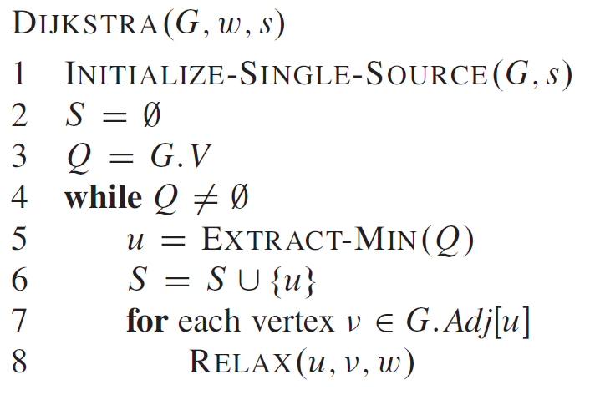
Breakdown of the Pseudocode
Line (1)_ Initialize a graph from a source
All edge weights are infinity
All node values are nil
O(E)
Line (2)_ Initialize empty shortest path
O(1)
Line (3)_ Add graph to some sort of Queue
O(1)
Line (4)_ While the Queue is not empty
O(V)
Line (5)_ Extract min vertex from Queue
O(lgV) – min Q = Fibonacci Heap
Line (6)_ Add next min vertex to shortest path
O(1)
Line (7 & 8)_ Relax adjacent nodes of the next min vertex
O(E)
Total Runtime
O(V lg V + E)

Slide 5
Time Complexity Analysis
The runtime for the algorithm is dependent on how minimum priority queue is implemented. Here are a few different ways to implement the min-priority queue.
Data Structure of Graph | Ordering | Time Complexity
Adjacency Matrix (Brute Force) | Searching | O(|V|²)
Adjacency List | Binary Heap | O(|E|log|V|)
Adjacency List | Fibonacci heaps | O(E + V lg V)

Slide 6
Loop Invariants
Prior to each iteration of the while loop, d[v] is the shortest path from S to V for each vertex V in S
Initialization – Since S is empty, then d[v] = 0 and invariant is true
Q = V - S
Maintenance – the claim is that when v is added to S, d[v] will be the shortest path to S (please refer to proof on chapter 24 page 660)
The proof is simply that even if there are indirect alternative routes to v, the algorithm is capable of finding the shortest path
Termination – since Q = 0, S = V and all vertices in S are the lightest weights in V
Notes:
Since Dijkstra is non-negative weights, the shortest distance every possible is 0

Slide 7

What is our Goal?
Our goal is to be a traveling circus and maximize profits by getting as many attendees as possible in our home state
The strategy is that if we visit the most populated cities. We may get the most attendees
Additionally, we want to be open for as many hours as we can so we so more attendees have more opportunity to visit us
This Photo by Unknown Author is licensed under CC BY-NC-ND

Slide 8

How to Achieve our Strategy
We can use Dijkstra’s Algorithm to reduce the travel distance so we can conserve as much time as possible
To make this work for our presentation and stay focused on our topic, we will eliminate some variables
Traffic no longer exists in Massachusetts!
All roads will have the fixed speed limits
100 mph!
Our car can occasionally become a boatmobile and
drive across water
With these variables eliminated, travel distance
will be proportional to time

Slide 9
Eight Most Populated Cities in Massachusetts
City | Population
Boston | 710,195
Worcester | 186,433
Springfield | 155,472
Cambridge | 121,783
Lowell | 112,646
Brockton | 96,155
Lynn | 96,032
New Bedford | 95,155

Slide 10
Let's see our Java Code
Main.java O(1)
Controller.java O(V)
Dijkstra.java
minDistance() O(V)
dijkstra() – brute force
Initialization O(V)
Algorithm O(V) * O(V) = O(V²)
getCityIndex() O(V)
getcity O(1)
getDistance O(1)
printResult() O(V)
bubbleSort() O(V²)
Our Java code’s runtime is O(V²)
Due to bubble sort and the use of an adjacency matrix
Since V is so small, our program is ok.
Improving runtime
Implement a different data structure using adjacency list
A better sorting algorithm

